Slide 1
Dynamic Programming
几道作业题的解析
2-1
2-3 链接中第5题
2-2是上一个链接中的第7题，思路一样，画表格

Slide 2
Dynamic Programming
Solve sub-problems just once and save answers in a table
Use a table instead of recursion
int Fib( int N )
{
if ( N <= 1 )
return 1;
else
return Fib( N - 1 ) + Fib( N - 2 );
}
T(N) ≥ T(N – 1) + T(N – 2)
T(N) ≥ F(N)
Notes:
要通过动态规划而不是递归来解决问题，关键方法是存储子问题的计算结果，这样我们只需计算每个不同的子问题一次

Slide 3
F6
Dynamic Programming
F5
F4
F4
F3
F3
F2
F3
F2
F2
F1
F2
F1
F1
F0
F2
F1
F1
F0
F1
F0
F1
F0
F1
F0
Trouble-maker: The growth of redundant calculations is explosive.
Solution: Record the two most recently computed values to avoid recursive calls.
int Fibonacci ( int N )
{ int i, Last, NextToLast, Answer;
if ( N <= 1 ) return 1;
Last = NextToLast = 1; /* F(0) = F(1) = 1 */
for ( i = 2; i <= N; i++ ) {
Answer = Last + NextToLast; /* F(i) = F(i-1) + F(i-2) */
NextToLast = Last; Last = Answer; /* update F(i-1) and F(i-2) */
} /* end-for */
return Answer;
}
T(N) = O(N)

Slide 4
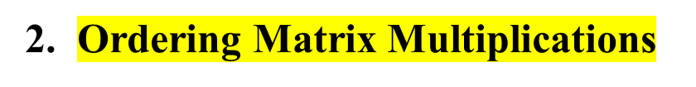
Dynamic Programming
〖Example〗 Suppose we are to multiply 4 matrices
M_{1 [ 10×20 ]} ∗ M_{2 [ 20×50 ]} ∗ M_{3 [ 50×1 ]} ∗ M_{4 [ 1×100 ]} .
If we multiply in the order
M_{1 [ 10×20 ]} ∗ ( M_{2 [ 20×50 ]} ∗ ( M_{3 [ 50×1 ]} ∗ M_{4 [ 1×100 ]} ) )
Then the computing time is
50 × 1 × 100 + 20 × 50 × 100 + 10 × 20 × 100 = 125,000
If we multiply in the order
( M_{1 [ 10×20 ]} ∗ ( M_{2 [ 20×50 ]} ∗ M_{3 [ 50×1 ]} ) ) ∗ M_{4 [ 1×100 ]}
Then the computing time is
20 × 50 × 1 + 10 × 20 × 1 + 10 × 1 × 100 = 2,200
Problem: In which order can we compute the product of n matrices with minimal computing time?

Slide 5



Dynamic Programming
Let b_{n} = number of different ways to compute M₁⋅ M₂⋅ ⋅ ⋅ ⋅ M_{n}. Then we have b₂ = 1, b₃ = 2, b₄ = 5, ⋅ ⋅ ⋅
Let M_{ij} = M_{i}⋅ ⋅ ⋅ ⋅ M_{j} . Then M_{1n} = M₁⋅ ⋅ ⋅ ⋅ M_{n} = M_{1i} ⋅ M_{i+1 n}
b_{n}
b_{i}
b_{n−i}
There are only O( N² ) values of M_{ij} .
b
=
O
(
4
n
)
/* Catalan number */
n
n
n
Suppose we are to multiply n matrices M₁ ∗ ⋅⋅⋅ ⋅⋅⋅ ∗ M_{n} where M_{i} is an r_{i−1}× r_{i} matrix. Let m_{ij} be the cost of the optimal way to compute M_{i} ∗ ⋅⋅⋅ ⋅⋅⋅ ∗ M_{j} . Then we have the recurrence equations:
Notes:
所以总的时间复杂度是O(N^3)

Slide 6
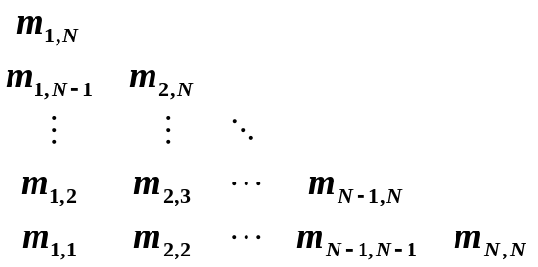
Dynamic Programming
/* r contains number of columns for each of the N matrices */
/* r[ 0 ] is the number of rows in matrix 1 */
/* Minimum number of multiplications is left in M[ 1 ][ N ] */
void OptMatrix( const long r[ ], int N, TwoDimArray M )
{ int i, j, k, L;
long ThisM;
for( i = 1; i <= N; i++ ) M[ i ][ i ] = 0;
for( k = 1; k < N; k++ ) /* k = j - i */
for( i = 1; i <= N - k; i++ ) { /* For each position */
j = i + k; M[ i ][ j ] = Infinity;
for( L = i; L < j; L++ ) {
ThisM = M[ i ][ L ] + M[ L + 1 ][ j ]
+ r[ i - 1 ] * r[ L ] * r[ j ];
if ( ThisM < M[ i ][ j ] ) /* Update min */
M[ i ][ j ] = ThisM;
} /* end for-L */
} /* end for-Left */
}
T(N) = O(N³ )
Notes:
M[i[的行所以是r[i-1

Slide 7
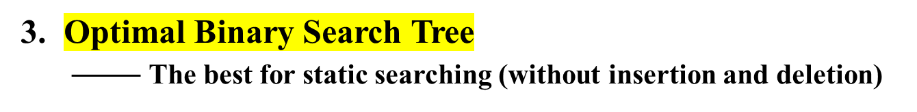

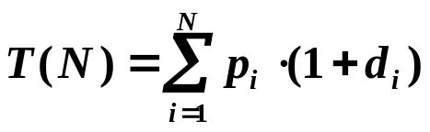
Dynamic Programming
Given N words w₁ < w₂ < …… < w_{N}, and the probability of searching for each w_{i} is p_{i} . Arrange these words in a binary search tree in a way that minimize the expected
total access time.
〖Example〗Given the following table of probabilities:
word
break
case
char
do
return
switch
void
probability
0.22
0.18
0.20
0.05
0.25
0.02
0.08
Notes:
因为是二叉搜索树，所以根节点定下来之后整个树就确定了，左小右大字典序排列了

Slide 8
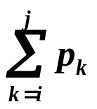
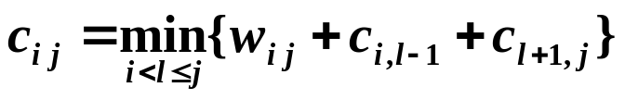
Dynamic Programming
T_{i j} ::= OBST for w_{i} , ……, w_{j} ( i < j )
c_{i j} ::= cost of T_{i j} ( c_{i i} = 0 )
r_{i j} ::= root of T_{i j}
w_{i j} ::= weight of T_{i j} = ( w_{i i} = p_{i} )
T_{1N} with root r_{1N},
weight w_{1N}, and
cost c_{1N} .
T_{i j}
w_{k}
L
w_{i}…w_{k−1}
R
w_{k+1}…w_{j}
c_{i j} = ?
p_{k} + cost( L ) + cost( R )
+ weight( L ) + weight( R )
= p_{k} + c_{i, k−1} + c_{k+1, j} + w_{i, k−1} + w_{k +1, j} = w_{i j} + c_{i, k−1} + c_{k +1, j}
T_{i j} is optimal ⇒ r_{i j} = k is such that
Notes:
贪心或者平衡树不可行
Wij的意义是因为根结点的存在，导致所有i 到j 的单词都加深一

Slide 9
Dynamic Programming
word
break
case
char
do
return
switch
void
probability
0.22
0.18
0.20
0.05
0.25
0.02
0.08
break.. break
case..case
char.. char
do..do
return..return
switch..switch
void.. void
0.22
break
0.18
case
0.20
char
0.05
do
0.25
return
0.02
switch
0.08
void
break.. case
case.. char
char..do
do.. return
return..switch
switch.. void
0.58
break
0.56
char
0.30
char
0.35
return
0.29
return
0.12
void
break.. char
case..do
char.. return
do.. switch
return.. void
1.02
case
0.66
char
0.80
return
0.39
return
0.47
return
break..do
case.. return
char.. switch
do.. void
1.17
case
1.21
char
0.84
return
0.57
return
char
break.. return
case.. switch
char.. void
break
return
1.83
char
1.27
char
1.02
return
break.. switch
case.. void
case
do
void
1.89
char
1.53
char
T(N) = O(N³ )
switch
break.. void
Please read 10.33 on p.419 for an O( N² ) algorithm.
2.15
char

Slide 10
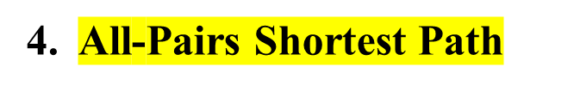

Dynamic Programming
For all pairs of v_{i} and v_{j} ( i ≠ j ), find the shortest path between.
Method 1 Use single-source algorithm for |V| times.
T = O( |V|³ ) – works fast on sparse graph.
Method 2 Define
D^{k}[ i ] [ j ] = min{ length of path i → { l ≤ k } → j }
and D⁻¹[ i ] [ j ] = Cost [ i ] [ j ]. Then the length of the shortest path from i to j is
D^{N−1}[ i ] [ j ].
Algorithm
Start from D⁻¹ and successively generate D⁰, D¹, ..., D^{N−1}. If D^{k−1} is done, then either
① k ∉ the shortest path i → { l ≤ k } → j ⇒ D^{k} = D^{k−1} ; or
② k ∈ the shortest path i → { l ≤ k } → j
= { the S.P. from i to k } ∪ {the S.P. from k to j }
⇒ D^{k} [ i ] [ j ] = D^{k−1}[ i ] [ k ] + D^{k−1}[ k ] [ j ]

Slide 11
Dynamic Programming
/* A[ ] contains the adjacency matrix with A[ i ][ i ] = 0 */
/* D[ ] contains the values of the shortest path */
/* N is the number of vertices */
/* A negative cycle exists iff D[ i ][ i ] < 0 */
void AllPairs( TwoDimArray A, TwoDimArray D, int N )
{ int i, j, k;
for ( i = 0; i < N; i++ ) /* Initialize D */
for( j = 0; j < N; j++ )
D[ i ][ j ] = A[ i ][ j ];
for( k = 0; k < N; k++ ) /* add one vertex k into the path */
for( i = 0; i < N; i++ )
for( j = 0; j < N; j++ )
if( D[ i ][ k ] + D[ k ][ j ] < D[ i ][ j ] )
/* Update shortest path */
D[ i ][ j ] = D[ i ][ k ] + D[ k ][ j ];
}
T(N) = O(N³ ), but faster in a dense graph.
只有非负的时候才有效
Notes:
这个k相当于是缓存了

Slide 12
Dynamic Programming
设计DP
☞ Characterize an optimal solution
☞ Recursively define the optimal values
☞ Compute the values in some order
☞ Reconstruct the solving strategy
动态规划都有个假设就是子问题最优
Notes:
因为如果是次优的话，把次优的改改就能获得更优的结果了

Slide 13
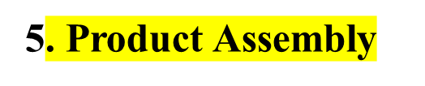
Dynamic Programming
Two assembly lines for the same car
Different technology (time) for each stage
One can change lines between stages
Minimize the total assembly time
……
t_{0,0}
t_{0,1}
t_{0,2}
t_{0->1,0}
……
Parts
t_{1->0,0}
Car
……
t_{1,0}
t_{1,1}
t_{1,2}
Exhaustive search gives O( 2^{N} ) time + O( N ) space

Slide 14
Dynamic Programming
☞ Characterize an optimal solution
stage
Parts
Car
Slower path to stage
Optimal solution
 An optimal solution contains an optimal solution of a sub-problem!

Slide 15


Dynamic Programming
☞ Recursively define the optimal values
An optimal path to stage is based on an optimal path to stage–1
stage
☞ Compute the values in some order
+
O( N ) time + O( N ) space
f[0][0]=0; f[1][0]=0;
for (stage=1; stage<=n; stage++){
for (line=0; line<=1; line++){
f[line][stage] = min(
f[ line][stage-1] + t_process[ line][stage-1],不换
f[1-line][stage-1] + t_transit[1-line][stage-1]);换
}
}
Solution = min(f[0][n],f[1][n]);

Slide 16
Dynamic Programming
☞ Reconstruct the solving strategy
f[0][0]=0; L[0][0]=0;
f[1][0]=0; L[1][0]=0;
for(stage=1; stage<=n; stage++){
for(line=0; line<=1; line++){
f_stay = f[ line][stage-1] + t_process[ line][stage-1];
f_move = f[1-line][stage-1] + t_transit[1-line][stage-1];
if (f_stay<f_move){
f[line][stage] = f_stay;
L[line][stage] = line;
}
else {
f[line][stage] = f_move;
L[line][stage] = 1-line;
}
}
}
line = f[0][n]<f[1][n]?0:1;
for(stage=n; stage>0; stage--){
plan[stage] = line;
line = L[line][stage];
}

